Slide 1
CS50 Week 8: HTML, CSS, JS
Albert
Before we get started:
Download zip file at this link: https://drive.google.com/drive/folders/11tvylNyRCyCk6SyOG8k3KYsC2oZ8g7hm?usp=sharing
Unzip the file and upload to your IDE

Slide 2
JavaScript

Slide 3
JavaScript, like Python, is much newer than C (1995 vs. 1972), but is also very heavily inspired by it.
To start writing JavaScript, open a file with the .js file extension.
Unlike Python which runs server-side, most JavaScript applications run client-side, on your own machine. (Modifications to JavaScript, such as the popular Node.js, is server-side.

Slide 4
JavaScript, HTML, and CSS together basically comprise the backbone of the internet.
Much like with CSS and <style> tags, you can directly write JS between <script> tags, but you can also link external JavaScript files (which is probably the preferred approach!) by way of the src attribute of <script> tags.

Slide 5
Variables in JavaScript do not require a type specifier, and do not need to be declared in advance. But there is a special keyword for introducing them.

Slide 6
Variables in JavaScript do not require a type specifier, and do not need to be declared in advance. But there is a special keyword for introducing them.
let x = 44;

Slide 7
Variables in JavaScript do not require a type specifier, and do not need to be declared in advance. But there is a special keyword for introducing them.
let x = 44;

Slide 8
Variables in JavaScript do not require a type specifier, and do not need to be declared in advance. But there is a special keyword for introducing them.
let x = 44;

Slide 9
Conditionals are the same as C, and curly braces are used to delimit the blocks again.

Slide 10
Conditionals are the same as C, and curly braces are used to delimit the blocks again.
if
else if
else
switch
?:

Slide 11
Loops are the same as C, and curly braces are used to delimit the blocks again.

Slide 12
Loops are the same as C, and curly braces are used to delimit the blocks again.
while
do-while
for

Slide 13
Functions are introduced with the function keyword (basically equivalent to Python’s def).
JavaScript functions can be anonymous--you don’t have to give them a name!
We’ll revisit this idea shortly.
By the way, Python technically has this ability too!

Slide 14
Declaring arrays (again called arrays in JavaScript) looks really similar to a Python list, and can contain mixed types as before.

Slide 15
Declaring arrays (again called arrays in JavaScript) looks really similar to a Python list.
let nums = [1, 2, 3, 4, 5];

Slide 16
As was the case with Python, JavaScript has the ability to behave as an object-oriented programming language, with properties contained within the object, and methods that apply only to objects that define those methods.
JavaScript objects look a lot like Python dictionaries:

Slide 17
As was the case with Python, JavaScript has the ability to behave as an object-oriented programming language, with properties contained within the object, and methods that apply only to objects that define those methods.
JavaScript objects look a lot like Python dictionaries:
let herbie = { year: 1963, model: "Beetle"};

Slide 18
Loops are the same as C, and curly braces are used to delimit the blocks again.
while
do-while
for
for ... in

Slide 19
How do we iterate across all of the keys of an object?
let herbie = { year: 1963,
model: "Beetle",
sound: "honk.mp3"
};

Slide 20
How do we iterate across all of the keys of an object?
let herbie = { year: 1963,
model: "Beetle",
sound: "honk.mp3"
};
for (let prop in herbie)
{
console.log(herbie[prop]);
}

Slide 21
How do we iterate across all of the keys of an object?
let herbie = { year: 1963,
model: "Beetle",
sound: "honk.mp3"
};
for (let prop in herbie)
{
console.log(herbie[prop]);
}
1963
Beetle
honk.mp3

Slide 22
How do we iterate across all of the keys of an object?
let herbie = { year: 1963,
model: "Beetle",
sound: "honk.mp3"
};
for (let prop in herbie)
{
console.log(prop);
}

Slide 23
How do we iterate across all of the keys of an object?
let herbie = { year: 1963,
model: "Beetle",
sound: "honk.mp3"
};
for (let prop in herbie)
{
console.log(prop);
}
year
model
sound

Slide 24
Loops are the same as C, and curly braces are used to delimit the blocks again.
while
do-while
for
for ... in
for ... of

Slide 25
How do we iterate across all of the elements of an array?)
let wkArray = ["Mon", "Tue", "Wed"];

Slide 26
How do we iterate across all of the elements of an array?)
let wkArray = ["Mon", "Tue", "Wed"];
for (let day of wkArray)
{
console.log(day);
}

Slide 27
How do we iterate across all of the elements of an array?)
let wkArray = ["Mon", "Tue", "Wed"];
for (let day of wkArray)
{
console.log(day);
}
Mon
Tue
Wed

Slide 28
Strings can be concatenated in JavaScript using the + operator… but be careful mixing types!

Slide 29
Strings can be concatenated in JavaScript using the + operator… but be careful mixing types!
console.log(wkArray[day] + " is day number "
+ (day + 1) + " of the week!");

Slide 30
Strings can be concatenated in JavaScript using the + operator… but be careful mixing types!
console.log(wkArray[day] + " is day number "
+ (day + 1) + " of the week!");

Slide 31
Strings can be concatenated in JavaScript using the + operator… but be careful mixing types!
console.log(wkArray[day] + " is day number "
+ (parseInt(day) + 1) +
" of the week!");

Slide 32
Strings can be concatenated in JavaScript using the + operator… but be careful mixing types!
As with Python, there are still underlying data types, we just don’t often have to worry about them. But here’s the tradeoff of losing the precise control we had in C!

Slide 33
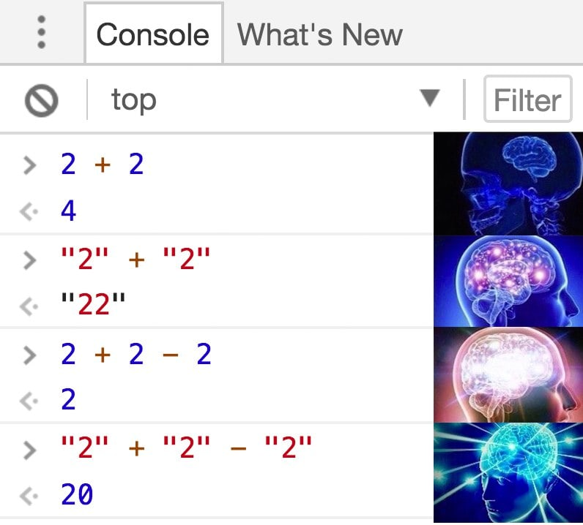

Slide 34
Arrays are a special case of an object (actually, everything in JavaScript in a special case of an object!). Many methods can be applied to them natively.
array.size()
array.pop()
array.push(x)
array.shift()
array.map()

Slide 35
Arrays are a special case of an object (actually, everything in JavaScript in a special case of an object!). Many methods can be applied to them natively.
array.size()
array.pop()
array.push(x)
array.shift()
array.map()

Slide 36
Arrays are a special case of an object (actually, everything in JavaScript in a special case of an object!). Many methods can be applied to them natively.
array.size()
array.pop()
array.push(x)
array.shift()
array.map()
This one will give us a good way to introduce anonymous functions.

Slide 37
map() accepts as its parameter a function to be applied to every element of the array. We could define the function in advance and pass it… or we could just define the function in our call to map()!

Slide 38
map() accepts as its parameter a function to be applied to every element of the array. We could define the function in advance and pass it… or we could just define the function in our call to map()!
let nums = [1, 2, 3, 4, 5];

Slide 39
map() accepts as its parameter a function to be applied to every element of the array. We could define the function in advance and pass it… or we could just define the function in our call to map()!
let nums = [1, 2, 3, 4, 5];
nums = nums.map()

Slide 40
map() accepts as its parameter a function to be applied to every element of the array. We could define the function in advance and pass it… or we could just define the function in our call to map()!
let nums = [1, 2, 3, 4, 5];
nums = nums.map(function(num) {
return num * 2;
});

Slide 41
map() accepts as its parameter a function to be applied to every element of the array. We could define the function in advance and pass it… or we could just define the function in our call to map()!
let nums = [2, 4, 6, 8, 10];
nums = nums.map(function(num) {
return num * 2;
});

Slide 42
An event in HTML/JavaScript is a response to user interaction with the web page. (e.g. user clicked a button, a page has finished loading…)
JavaScript supports event handlers, which are functions that respond to HTML events.

Slide 43
<html>
<head>
<title>Event Handlers</title>
</head>
<body>
<button onclick="">Button 1</button>
<button onclick="">Button 2</button>
</body>
</html>

Slide 44
An event in HTML/JavaScript is a response to user interaction with the web page (e.g. user clicked a button, a page has finished loading…)
JavaScript supports event handlers, which are functions (usually called callbacks) that respond to HTML events.
We can write a generic event handler here, which will automatically create an event object, that will tell us which of the two buttons was clicked.

Slide 45
DOM

Slide 46
JavaScript has a special object called the document object, which is effectively a single object that represents an entire web page.
Because objects can have numerous fields, can because those fields can be of any type, including being themselves objects, this lends itself to a nice hierarchical organization.
By organizing an entire page into a JavaScript object, we can manipulate its elements programmatically.

Slide 47
<!DOCTYPE>
<html>
<head>
<title>Hello, world</title>
</head>
<body>
<h2>Here's my page</h2>
<p>World, hello</p>
<a href="test.html">Link</a>
</body>
</html>

Slide 48
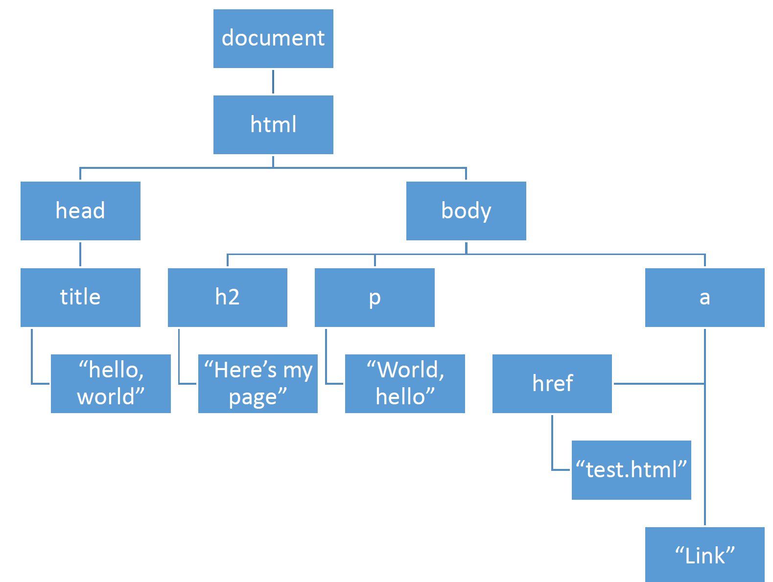
<html>
<head>
<title>Hello, world</title>
</head>
<body>
<h2>Here's my page</h2>
<p>World, hello</p>
<a href="test.html">Link</a>
</body>
</html>

Slide 49
<html>
<head>
<title>Hello, world</title>
</head>
<body>
<h2>Here's my page</h2>
<p>World, hello</p>
<a href="test.html">Link</a>
</body>
</html>

Slide 50
<html>
<head>
<title>Hello, world</title>
</head>
<body>
<h2>Here's my page</h2>
<p>World, hello</p>
<a href="test.html">Link</a>
</body>
</html>

Slide 51
<html>
<head>
<title>Hello, world</title>
</head>
<body>
<h2>Here's my page</h2>
<p>World, hello</p>
<a href="test.html">Link</a>
</body>
</html>

Slide 52
<html>
<head>
<title>Hello, world</title>
</head>
<body>
<h2>Here's my page</h2>
<p>World, hello</p>
<a href="test.html">Link</a>
</body>
</html>

Slide 53
The document object itself and all of the objects within it have a number of properties and methods that can be used to drill down to a very specific part of your site.
By modifying those properties and calling those methods, the contents of our pages can change without us needing to refresh.

Slide 54
Some examples of DOM properties include:

Slide 55
Some examples of DOM properties include:
PROPERTY | DESCRIPTION
innerHTML | Holds the HTML inside a set of HTML tags.
nodeName | The name of an HTML element or element’s attribute.
id | The "id" attribute of an HTML element
parentNode | A reference to the node one level up in the DOM.
childNodes | An array of references to the nodes one level down in the DOM.
attributes | An array of attributes of an HTML element.
style | An object encapsulating the CSS/HTML styling of an element.

Slide 56
Some examples of DOM methods include:

Slide 57
Some examples of DOM methods include:
METHOD | DESCRIPTION
getElementById(id) | Gets the element with a given ID below this point in the DOM.
getElementsByTagName(tag) | Gets all elements with the given tag below this point in the DOM.
appendChild(node) | Add the given node to the DOM below this point.
removeChild(node) | Remove the specified child node from the DOM.

Slide 58
Some examples of DOM methods include:
METHOD | DESCRIPTION
getElementById(id) | Gets the element with a given ID below this point in the DOM.
getElementsByTagName(tag) | Gets all elements with the given tag below this point in the DOM.
appendChild(node) | Add the given node to the DOM below this point.
removeChild(node) | Remove the specified child node from the DOM.

Slide 59
Starting at document, we can get anywhere on our page we want using DOM properties and methods.
Because DOM manipulation is so common with JavaScript, and because the code can get quite lengthy, people wanted alternatives. The jQuery open-source library for JavaScript is designed to simplify client-side scripting operations, such as DOM manipulation.

Slide 60
JavaScript to set the background color of the HTML element with ID colorDiv to be green:
document.getElementById("colorDiv").style.backgroundColor = "green";

Slide 61
jQuery to set the background color of the HTML element with ID colorDiv to be green:
$("colorDiv").css("background-color", "green");

Slide 62
jQuery to set the background color of the HTML element with ID colorDiv to be green:
$("colorDiv").css("background-color", "green");
More information about the various potential use cases for jQuery at
https://api.jquery.com

Slide 63
Practice!
Open the files you uploaded to your IDE!

Slide 64
Lab: Trivia
https://cs50.harvard.edu/college/2020/fall/labs/8/

